Slide 1
Centralized Remote Agriculture Pump Control System For Farmers
- TEAM MKS

Slide 2
introduction
The need for electronically controlled water level in water pumps and soil in a field ,even in the absence of human beings ,to ensure constant water distribution is a serious demand . We therefore intend to provide a solution by constructing an electronic system in rural areas for farmers, that has a capability of monitoring the water level that flows through a pipe and also the amount of moisture in a soil and also to detect if the amount of water flowing through the pipe is less and inform the farmer immediately .
The project involves the use of a flow sensor, soil moisture sensor , GSM GPRS module and Arduino Uno. The flow sensor monitors the flow of water through the pipe and sends an SMS through the GSM GPRS module to the farmer asking him to turn on the pump and after the irrigation is done and a certain moisture level is reached , the soil moisture sensor notifies the farmer again through SMS to turn off the pump. This way we will be able to save water ,time and energy of the farmer.

Slide 3
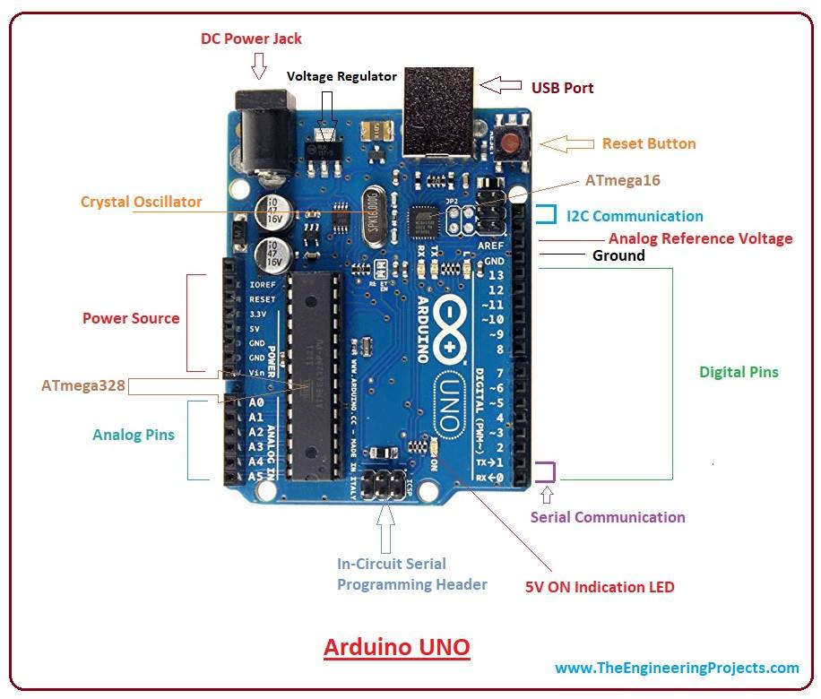
Arduino uno
1) Physical Computing – using components that can interact with people and with the world around us
2) The Arduino was originally developed for artists and designers to prototype interactive displays
3) Developed for non-scientists
4) Minimalist programming
“Forgiving” circuitry that can handle a wide variety of wiring errors

Slide 4
What can we learn about the arduino
Introductory electronics (voltage, current, resistance)
How sensors and actuators work
Rudimentary programming
Design of basic scientific equipment
Troubleshooting
Challenges of communicating with users through a project (e.g., messages, formatting numbers, ease of use, etc.)
Statistics and variation in data gathering

Slide 5
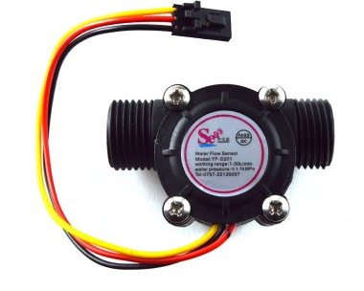
Flow sensor
Water flow sensor consists of a plastic valve body, a water rotor, and a hall-effect sensor. When water flows through the rotor, rotor rolls. Its speed changes with different rate of flow. The hall-effect sensor outputs the corresponding pulse signal. This one is suitable to detect flow in water dispenser or coffee machine. We have a comprehensive line of water flow sensors in different diameters. Check them out to find the one that meets your need most.

Slide 6
features
Compact, Easy to Install
High Sealing Performance
High Quality Hall Effect Sensor
RoHS Compliant

Slide 7
Specifications
Mini. Wokring Voltage: DC 4.5V
Max. Working Current: 15mA (DC 5V)
Working Voltage: DC 5V~24V
Flow Rate Range: 1~30L/min
Load Capacity: ?10mA (DC 5V)
Operating Temperature: ?80?
Liquid Temperature: ?120?
Operating Humidity: 35%~90%RH
Water Pressure: ?1.75MPa
Storage Temperature: -25~+ 80?
Storage Humidity: 25%~95%RH

Slide 8
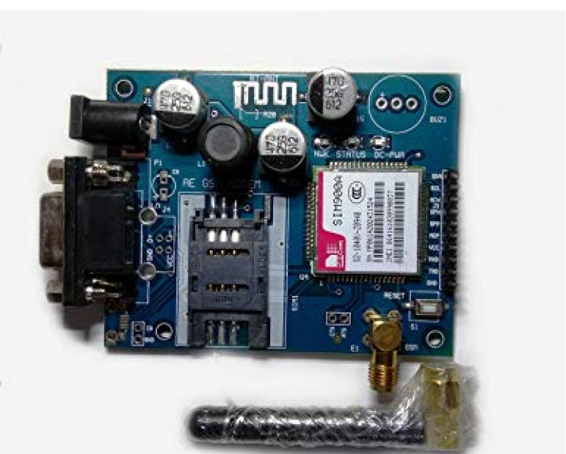
GSM GPRS MODULE
Global System for Mobile (GSM) is a second generation cellular standard developed to cater voice services and data delivery using digital modulation

Slide 9
GSM HISTORY
• Aim : to replace the incompatible analog system
• Presently the responsibility of GSM standardization resides with special mobile group under ETSI ( European telecommunication Standards Institute )
Full set of specifications phase-I became available in 1990
• Under ETSI, GSM is named as “ Global System for Mobile communication “
• Today many providers all over the world use GSM (more than 135
countries in Asia, Africa, Europe, Australia, America)
• More than 1300 million subscribers in world and 45 million subscriber in India.

Slide 10
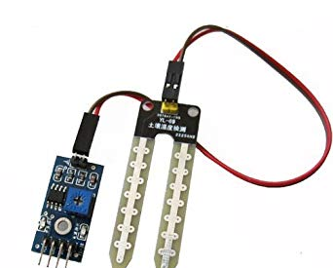
SOIL MOISTURE SENSOR
This sensor can be used to test the moisture of soil, when the soil is having water shortage, the module output is at high level, else the output is at low level. By using this sensor one can automatically water the flower plant, or any other plants requiring automatic watering technique. Module triple output mode, digital output is simple, analog output more accurate, serial output with exact readings.

Slide 11
FEATURES
Sensitivity adjustable.
Has fixed bolt hole, convenient installation.
Threshold level can be configured.
Module triple output mode, digital output is simple, analog output more accurate, serial output with exact readings. Applications
Agriculture
Landscape irrigation Specifications Parameter Value Operating Voltage +5v dc regulated Soil moisture Digital value is indicated by out pin

